Slide 1
GRADE 7 ACCELERATED · UNIT 3 · LESSON 8
Writing Large Numbers in Scientific Notation
MA.8.NSO.1.4
I can write a large number in scientific notation, read one back into standard form, and find how many times larger one number is than another.
Yesterday the exponent laws finished — numbers and letters.
Today they go to work on twenty-digit numbers.
Grade 7 Accelerated · Unit 3 · Lesson 8 — Writing Large Numbers in Scientific Notation
1

Slide 2



Warm-Up
On your own. Four minutes. No notes.
1. Rewrite with a positive exponent:
2. Find the value:
3. Find the value:
4. In 4,500,000, which place is the 4 in?
Grade 7 Accelerated · Unit 3 · Lesson 8 — Writing Large Numbers in Scientific Notation
2

Slide 3
Warm-Up
Answers.
1. Rewrite with a positive exponent:
4/x³
2. Find the value:
10⁶ = 1,000,000
3. Find the value:
11
4. In 4,500,000, which place is the 4 in?
millions
Grade 7 Accelerated · Unit 3 · Lesson 8 — Writing Large Numbers in Scientific Notation
3

Slide 4
Notes
Copy the table.
I. Powers of ten name the places
10¹ | 10² | 10³ | 10⁴ | 10⁵ | 10⁶
10 | 100 | 1,000 | 10,000 | 100,000 | 1,000,000
The exponent counts the zeros — and names the place of the 1.
Grade 7 Accelerated · Unit 3 · Lesson 8 — Writing Large Numbers in Scientific Notation
4

Slide 5




Notes
II. Scientific notation
with
The coefficient is at least 1 and less than 10: one nonzero digit before the decimal point.
The exponent is how many places the decimal point moves: 26,000,000. → 2.6, seven places, so 10⁷.
Grade 7 Accelerated · Unit 3 · Lesson 8 — Writing Large Numbers in Scientific Notation
5

Slide 6
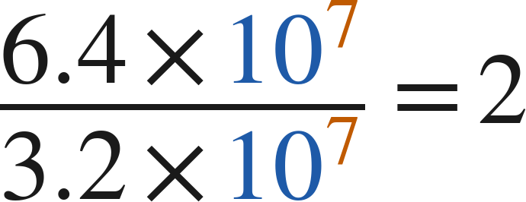
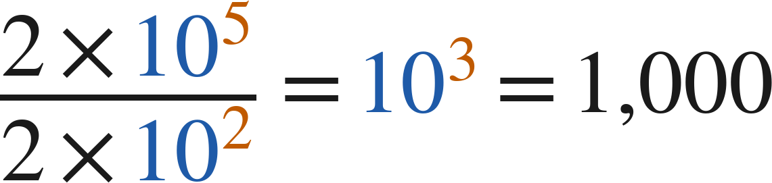
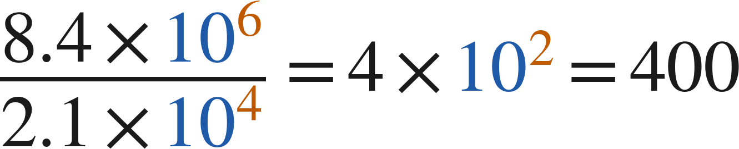
Notes
III. How many times larger?
Divide the coefficients. Divide the powers of 10. Multiply the two results.
On a screen, 8.4E6 means 8.4 × 10⁶.
Grade 7 Accelerated · Unit 3 · Lesson 8 — Writing Large Numbers in Scientific Notation
6

Slide 7
Example 1
Standard form to scientific notation.
In 2018, funding for education in Florida totaled 30,100,000,000 dollars.
Express this value in scientific notation.
Grade 7 Accelerated · Unit 3 · Lesson 8 — Writing Large Numbers in Scientific Notation
7

Slide 8
Example 1
Worked.
the 3 is in the ten-billions place
check
Answer: 3.01 × 10¹⁰
Grade 7 Accelerated · Unit 3 · Lesson 8 — Writing Large Numbers in Scientific Notation
8

Slide 9
Your Turn
Same steps, your numbers. Boards up when done.
A painting sold for 110,500,000 dollars. Write this value in scientific notation.
Grade 7 Accelerated · Unit 3 · Lesson 8 — Writing Large Numbers in Scientific Notation
9

Slide 10
Your Turn
Answer.
A painting sold for 110,500,000 dollars. Write this value in scientific notation.
the 1 is in the hundred-millions place
Answer: 1.105 × 10⁸
Grade 7 Accelerated · Unit 3 · Lesson 8 — Writing Large Numbers in Scientific Notation
10

Slide 11


Example 2
How many times larger?
How many times larger is
than
?
Grade 7 Accelerated · Unit 3 · Lesson 8 — Writing Large Numbers in Scientific Notation
11

Slide 12
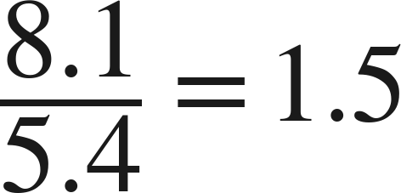
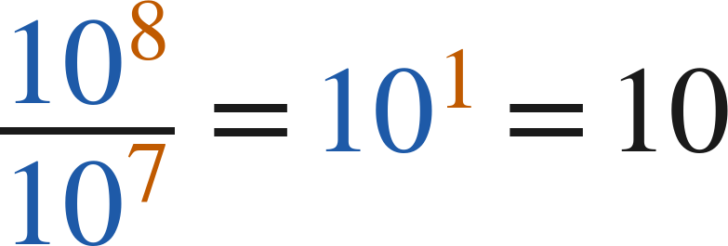

Example 2
Worked.
coefficients
powers of 10: subtract the exponents
multiply the two results
Answer: 15 times larger
Grade 7 Accelerated · Unit 3 · Lesson 8 — Writing Large Numbers in Scientific Notation
12

Slide 13


Your Turn
Same steps, your numbers. Boards up when done.
Everglades alligators:
Florida alligators:
About how many times larger is the Florida number?
Grade 7 Accelerated · Unit 3 · Lesson 8 — Writing Large Numbers in Scientific Notation
13

Slide 14


Your Turn
Answer.
Everglades alligators:
Florida alligators:
About how many times larger is the Florida number?
0.75 × 10 = 7.5
Answer: about 7.5 times larger
Grade 7 Accelerated · Unit 3 · Lesson 8 — Writing Large Numbers in Scientific Notation
14

Slide 15
Whiteboards · Question 1 of 9
Boards up on three.
Write 4,000,000 in scientific notation.
Answer it.
Which place is the 4 in?
Grade 7 Accelerated · Unit 3 · Lesson 8 — Writing Large Numbers in Scientific Notation
15

Slide 16
Whiteboards · Question 1 of 9
Answer.
Write 4,000,000 in scientific notation.
4 millions
Answer: 4 × 10⁶
Grade 7 Accelerated · Unit 3 · Lesson 8 — Writing Large Numbers in Scientific Notation
16

Slide 17

Whiteboards · Question 2 of 9
Boards up on three.
Write
in standard form.
Answer it.
Move the point four places.
Grade 7 Accelerated · Unit 3 · Lesson 8 — Writing Large Numbers in Scientific Notation
17

Slide 18

Whiteboards · Question 2 of 9
Answer.
Write
in standard form.
7.2 × 10,000
Answer: 72,000
Grade 7 Accelerated · Unit 3 · Lesson 8 — Writing Large Numbers in Scientific Notation
18

Slide 19
Whiteboards · Question 3 of 9
Boards up on three.
A stadium's renovation used 356,000 bolts.
The stadium seats 71,000 people.
Write the number of bolts in scientific notation.
Answer it.
Grade 7 Accelerated · Unit 3 · Lesson 8 — Writing Large Numbers in Scientific Notation
19

Slide 20
Whiteboards · Question 3 of 9
Answer.
A stadium's renovation used 356,000 bolts.
The stadium seats 71,000 people.
Write the number of bolts in scientific notation.
3.56 hundred-thousands
Answer: 3.56 × 10⁵
Grade 7 Accelerated · Unit 3 · Lesson 8 — Writing Large Numbers in Scientific Notation
20

Slide 21


Whiteboards · Question 4 of 9
Boards up on three.
Which is greater,
or
?
Answer it.
Look at the powers first.
Grade 7 Accelerated · Unit 3 · Lesson 8 — Writing Large Numbers in Scientific Notation
21

Slide 22


Whiteboards · Question 4 of 9
Answer.
Which is greater,
or
?
950,000 versus 1,200,000
Answer: 1.2 × 10⁶
Grade 7 Accelerated · Unit 3 · Lesson 8 — Writing Large Numbers in Scientific Notation
22

Slide 23
Whiteboards · Question 5 of 9
Boards up on three.
Which is 52,000,000 written in scientific notation?
A. 5.2 × 10⁸
B. 5.2 × 10⁷
C. 52 × 10⁶
D. 5.2 × 10⁶
Answer it.
Grade 7 Accelerated · Unit 3 · Lesson 8 — Writing Large Numbers in Scientific Notation
23

Slide 24
Whiteboards · Question 5 of 9
Answer.
Which is 52,000,000 written in scientific notation?
A. 5.2 × 10⁸
B. 5.2 × 10⁷
C. 52 × 10⁶
D. 5.2 × 10⁶
Answer: B — 5.2 × 10⁷
Grade 7 Accelerated · Unit 3 · Lesson 8 — Writing Large Numbers in Scientific Notation
24

Slide 25


Whiteboards · Question 6 of 9
Boards up on three.
How many times larger is
than
?
A. 1.6
B. 3
C. 1,000
D. 300
Answer it.
Grade 7 Accelerated · Unit 3 · Lesson 8 — Writing Large Numbers in Scientific Notation
25

Slide 26


Whiteboards · Question 6 of 9
Answer.
How many times larger is
than
?
A. 1.6
B. 3
C. 1,000
D. 300
Answer: C — 1,000
Grade 7 Accelerated · Unit 3 · Lesson 8 — Writing Large Numbers in Scientific Notation
26

Slide 27


Whiteboards · Question 7 of 9
Boards up on three.
How many times larger is
than
?
Answer it.
Coefficients, then powers, then multiply.
Grade 7 Accelerated · Unit 3 · Lesson 8 — Writing Large Numbers in Scientific Notation
27

Slide 28


Whiteboards · Question 7 of 9
Answer.
How many times larger is
than
?
4 × 10²
Answer: 400
Grade 7 Accelerated · Unit 3 · Lesson 8 — Writing Large Numbers in Scientific Notation
28

Slide 29
Whiteboards · Question 8 of 9
Boards up on three.
A computer displays a number as 3.5E9.
Write the number in standard form.
Answer it.
E is not an error.
Grade 7 Accelerated · Unit 3 · Lesson 8 — Writing Large Numbers in Scientific Notation
29

Slide 30
Whiteboards · Question 8 of 9
Answer.
A computer displays a number as 3.5E9.
Write the number in standard form.
3.5 × 10⁹
Answer: 3,500,000,000
Grade 7 Accelerated · Unit 3 · Lesson 8 — Writing Large Numbers in Scientific Notation
30

Slide 31

Whiteboards · Question 9 of 9
Take your time. Boards up when you have written it.
Marcus writes 2,000,000 as
.
Is his expression equal to 2,000,000? Is it scientific notation? Explain.
Write your answer in sentences.
Use the definition.
Grade 7 Accelerated · Unit 3 · Lesson 8 — Writing Large Numbers in Scientific Notation
31

Slide 32

Whiteboards · Question 9 of 9
Answer.
Marcus writes 2,000,000 as
.
Is his expression equal to 2,000,000? Is it scientific notation? Explain.
equal, yes — scientific notation, no
Answer: Equal, yes. Scientific notation, no: 20 is not less than 10. 2 × 10⁶.
Grade 7 Accelerated · Unit 3 · Lesson 8 — Writing Large Numbers in Scientific Notation
32

Slide 33
Independent Set
Six questions. On your own, in silence.
1.
Six questions. Work down the page.
2.
Show the step that does the work, not just the answer.
3.
Silence until the six minutes are up.
Grade 7 Accelerated · Unit 3 · Lesson 8 — Writing Large Numbers in Scientific Notation
33

Slide 34
IXL
Last five minutes.
1.
Open IXL and start today's skills.
2.
Work on paper where the question needs work. The answer box does not show it.
3.
Every skill listed is required, to a SmartScore of 67. Due at the start of the next class.
Today's skills — all required
Convert between standard and scientific notation: large numbers — 2AL
Compare large numbers — WEZ
Powers of ten — LJQ
Grade 7 Accelerated · Unit 3 · Lesson 8 — Writing Large Numbers in Scientific Notation
34

